Slide 1
電腦視覺與深度學習 (Computer Vision and Deep Learning) Homework 2
TA:
Lydia: lydia2200284@gmail.com
Office Hour: 17:00~19:00, Mon.
10:00~12:00, Wed.
At CSIE 9F Robotics Lab.

Slide 2
Notices (1/2)
Copying homework is strictly prohibited!! Penalty: Grade will be zero for both persons!!
If the code can’t run, you can come to our Lab within one week and show that your programming can work. Otherwise you will get zero!!
Due date => Midnight 23:59:59 on 2020/12/30 (Wed.)
No delay. If you submit homework after deadline, you will get 0.
Upload to => 140.116.154.1 -> Upload/Homework/Hw2
User ID: cvdl2020 Password: cvdl2020
Format
Filename: Hw2_StudentID_Name_Version.rar
Ex: Hw2_F71234567_林小明_V1.rar
If you want to update your file, you should update your version to be V2, ex: Hw2_F71234567_林小明_V2.rar
Content: project folder*( including the pictures ) *note: remove your “Debug” folder to reduce file size

Slide 3
Notices (2/2)
Python
Python 3.7 (https://www.python.org/downloads/)
opencv-contrib-python (3.4.2.17)
Matplotlib 3.1.1
UI framework: pyqt5 (5.15.1)
C++ (check MFC guide in ftp)
OpenCV 3.3.1 (https://opencv.org/release.html)
Visual Studio 2015 (download from http://www.cc.ncku.edu.tw/download/)
UI framework: MFC

Slide 4
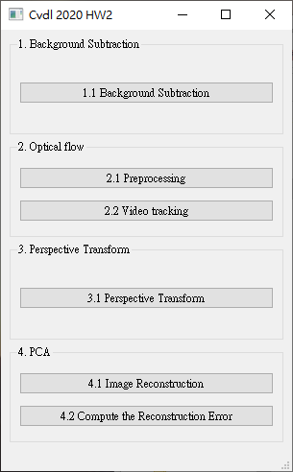
Grading
1. (20%) Background Subtraction (出題：Brian)
2. (20%) Optical Flow (出題：Kevin) 2.1 Preprocessing (10%)
2.2 Video tracking (10%)
3. (20%) Perspective Transform (出題：Max)
4. (20%) PCA (出題：Mark)
4.1 Image Reconstruction (10%)
4.2 Compute the reconstruction error (10%)
5. (20%) Dogs and Cats classification Using ResNet50 (出題：Bill)
UI example

Slide 5
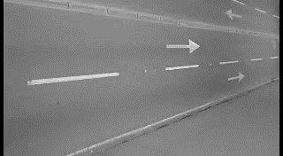
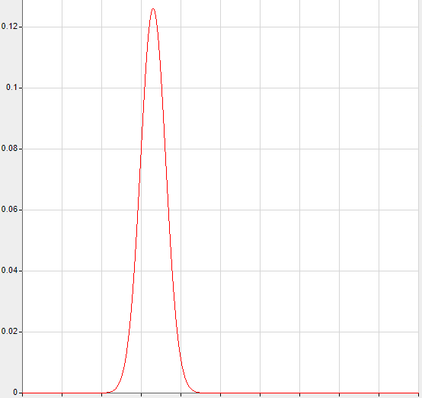
1. (20%) Background Subtraction: Simple Gaussian Model (1/2) (出題：Brian)
Given a video: bgSub.mp4
Q: 1) Click the button “1.1 Background Subtraction” to open two windows:
One shows the original video: bgSub.mp4
The other is the foreground video.
Use first 50 frames to build the background model
DO NOT use OpenCV function cv2.createbackgroundSubstractor()
1. Build background model
Build one gaussian model at every pixel position
frame = 0 ~ 50
Image height
Background gaussian model
Each pixel will have a mean
and a standard deviation (total width x height models)
0~50 frame
Image width
Output: w x h gaussian models (mean and std)
2. Test new pixel belongs to background or foreground
mean ex: 25
mean ex: 25
std * 5 ex: 3*5
std * 5 ex: 3*5
Ex:
Mean = 25
Std (standard deviation) = 3
new pixel value ex: 28
new pixel value ex: 60
Belongs to Background
Belongs to Foreground

Slide 6
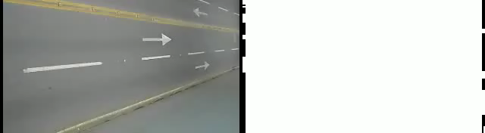
1. (20%) Background Subtraction: Simple Gaussian Model (2/2) (出題：Brian)
Hint : (1) Convert video frames to gray
(2) For every pixels in video from 0~50 frames, build a gaussian model with mean and standard deviation (if standard deviation is less then 5, set to 5)
(3) For frame > 50, test every frame pixels with respective gaussian model. If gray value difference between testing pixel and gaussian mean is larger than 5 times standard deviation, set testing pixel to 255 (foreground, white), 0 (background, black) otherwise.
Demo video:

